Slide 1
ThisMonday
Ruben Rosen
Neil Abraham

Slide 2
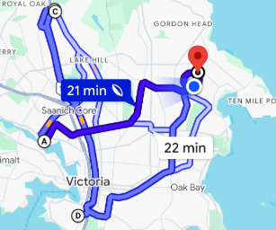
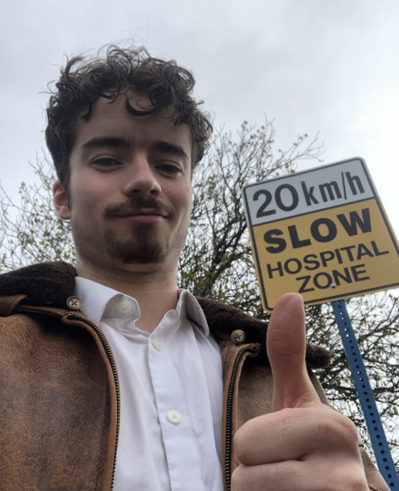
Market Research

Slide 3
What a Doctor Said
“In clinical practice, it can be very challenging to access timely mental health support in the local community.”
“Once refined and populated, this would be a very useful point-of-care clinical tool.”
Dr. Tom Rimmer, General Practitioner

Slide 4

Our Solution: ThisMonday

Slide 5
Our Design is:
Simply
Real
Impactful

Slide 6

Thank you

